Slide 1
Should there be a mandatory code of conduct for all data scientists?

Slide 2
What would a code of ethics look like in the data science world?

Slide 3
The Oxford Munich Code of Conduct for professional Data Scientists.

Slide 4
Lawfulness
Operate within the law to the best of your ability.
Don’t be intentionally ignorant.

Slide 5
Competence
Stay sharp to avoid costly mistakes.
Errors in data can make people not like you very much.

Slide 6
Dealing with data
Keep track of your work:
How you collected data
How you manipulated data

Slide 7
Algorithms and models
Try to avoid all types of bias to the best of your ability:
Constantly check for biases in your work.
Don’t jump to conclusions:
Correlation does not imply causation

Slide 8
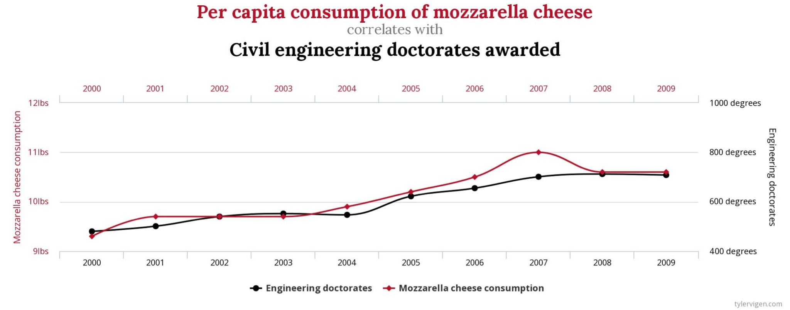

Slide 9
Transparency
Don’t mislead or manipulate people with the data you’re working with.
Not very nice
Another reason people won’t like you
Not very ethical

Slide 10
Working with others
Share ALL important information with others, even if it doesn’t suit the result you’d like to obtain.
Tell your colleagues that they aren’t practicing in an ethical manner.
Hey you over there. Yeah you. You aren’t really practicing in an ethical manner, that’s not cool. Oxford Munich would be real mad at you right now.
This is guaranteed to work everytime. Promise.

Slide 11
Future issues?
Room for expansion. What ethical issues will we face in the future?
Killer cars, BitCoin, England winning the euros?
How will a code of conduct keep up with this?
Open to change
Stay informed

Slide 12
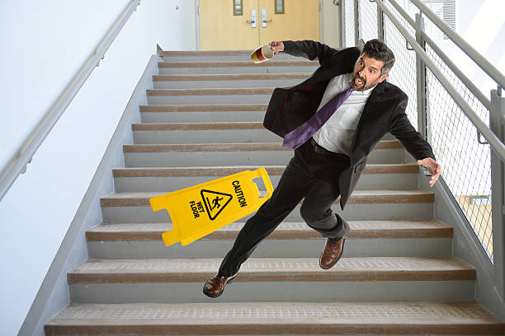
This seems a good starting point
Where might it fall down?

Slide 13
Restrictive
An enforced code of conduct could be perceived as restrictive and potentially hinder positive things that people are trying to achieve.
What if there’s good reason to breach the code?
E.g - The nice old folks woman who wants to track down, I mean track old people.

Slide 14
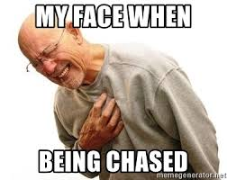
Time consuming
Time spent worrying about breaching the code
Time spent trying to keep up to date with the code
Time spent upskilling to avoid bad practice
Time spent being angry you can’t track down old people

Slide 15
How would it be enforced?
What if your colleague doesn’t listen to you when you say:
‘Hey you over there. Yeah you. You aren’t really practicing in an ethical manner, that’s not cool. Oxford Munich would be real mad at you right now.’
How would you know someone had breached the code of conduct?

Slide 16
I believe a code of conduct is necessary.
Legal enforcement would be required.
Pros outweigh the cons.
Eliminate some of the negative connotations people have with data.

